Slide 1

BHARAT INSTITUTE OF ENGINEERING AND TECHNOLOGY Ibrahimpatnam – 501 510, Hyderabad
Department of Computer Science and Engineering
Major Project Work
PROJECT TITLE:
Crop Yield Prediction using Temperature and Rainfall parameters using Artificial Neural Network (ANN)
Viva Voice
Date: 7 July 2022
Submitted by:
18E11A0503 – B Ajay Kumar
18E11A0510 - G Bharath Reddy
18E11A0532 - M Shiva Kumar
19E15A0503 - M Akhil Netha
Project Guide:
Mr N S S S Girish Kumar
Assistant Professor, CSE

Slide 2
Contents:
Abstract
Introduction
Existing System
Proposed System
Design Methodology
Conclusion
References

Slide 3
System Requirements:
Hardware Requirements
Minimum Intel Core i3
4GB RAM is recommended
5GB Disk Space is recommended
Software Requirements
A PC/Laptop with Windows 8 or newer, 64-bit.
Jupyter Notebook (Anaconda Individual Edition for Windows)
Install the required python modules
(keras, tensorflow, numpy, pandas, sklearn, matplotlib)

Slide 4
Abstract:
In India, agriculture contributes about 23% of GDP and the share of the employed workforce is 59%. India is the second largest producer of agricultural crops. Technological inputs can help farmers get more productive.
Predicting the yield of different crops can help farmers make decisions about which crops to grow. The project focused on predicting the yield of different crops using a neural network regression model.
Crop cycle data for summer, Kharif, rabi, fall and full year are used. The dataset was filtered using the Python Pandas and Pandas Profiling tools for data retrieval. The model was developed in using a multilayer perceptron neural network. Initially, the result is obtained considering the RMS attachment of the optimizer with 45% accuracy, then it will be improved to 90% by increasing the layers, adjusting the weight of , tilt and change the optimizer for Adam.

Slide 5
Existing system:
Crop yield prediction has been an area of ​​great current research interest since the years . However, at first the work was mainly focused on studying models of linear systems and was therefore only concerned interested in the linear relationship between the different agricultural parameters.
As a result, most conventional or traditional models cannot work properly because they cannot deal effectively with the complexity and non-linearity of the data.
Basically, crop forecasting models can be divided into two classes; statistical modeling and crop simulation . The first stage of modeling usually involves statistical methods.

Slide 6
Proposed System:
Engineering-based models of intelligent systems (IS) can overcome this limitation. This type of technique can produce good results by manipulating the simple or complex raw data they run to compete with more complex models.
The most common ISs technique that has been used for crop or wheat prediction models is the Artificial Neural Network (ANN). The project focuses on predicting yield of different crops using a neural network regression model . Crop cycle data for summer, Kharif, Rabi, autumn and year-round will be use.
Experimental parameters that will be taken into account for the project are cultivated area, crop, states, district, season, year and yield or yield, etc. The dataset will be filtered using the Pandas and Pandas Profile tools in Python to retrieve the data

Slide 7
ANN – An Overview
Artificial Neural network is the system designed to work like a human brain. The computational system inspired by but not identical to the human brain. The ANN systems or model learn from the facts and experiences feed to them and will react to the input situation depending on training given to it. As we add more training it will work more efficiently.
Advantages of Proposed System:
This type of technique can produce good results by manipulating raw and simple or complex data which they perform in competitively with the more complex models.
Corruption of one or more cells of ANN does not prevent it from generating output. This feature makes the networks fault-tolerance
The ANN model develops a formula to ascertain the relationship using a large number of input and output examples, to establish model for yield predictions. Also the error rate with the actual will be shown with the assist of Mean Square Error (MSE).

Slide 8
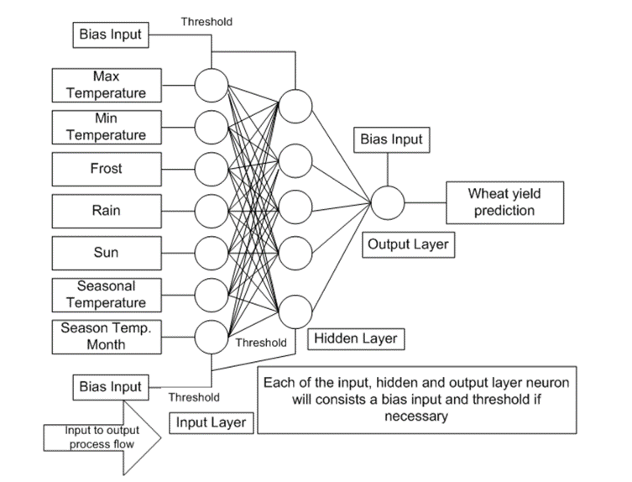
Design Methodology:

Slide 9
Obtaining Datasets and Pre-processing:
Step 1: Acquiring each parameter (Area, Crop, State, District, Season, Year and Production) monthly mean records.
Step 2: Selecting a subset of the dataset.
Step 3: Calculating the Number of records Based on Year with Different categorical Variables
Step 4: Visualizing a dataset with matplotlib and Seaborn python library
Step 5: Then row data will be passed through different data Pre-processing steps.
Step 6: Using statistical methods the relation between different variables like are analyzed. When Variables are Categorical used – Frequency, Count

Slide 10
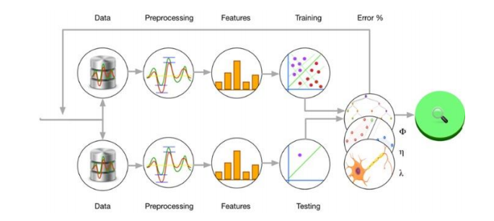
Construction of Prediction Model:
Fig : Artificial Neural Network structure Crop Yield Prediction

Slide 11
Construction of Prediction Model (Cont.):
Step 7: For preparing the data set for applying multilayer perceptron technique, unwanted columns were removed. They were sr. no, name of the district and year.
Step 8: The data set was then sorted on the basis of area. Outliers will be detected and omitted using various Data cleaning methods available.
Step 9: the data which is present in label from converted to encoding using sklearn.
Step 10: The dataset was then sorted on the basis production.
Step 11: we considered production as output parameter and features like: crop, area, district, and season.
Step 12: This data set was then saved in .csv format for further application of the multilayer perceptron technique in Python TensorFlow.
Step 13: Model is trained Using linear Regression with Neural Network with Adam optimizer and 3 layers.

Slide 12
Conclusion:
The proposed model with back-propagation tries to reduce the MSE using the RELU activation and gradient descent function. The learning rate for each class was kept constant, i.e. 0.001. When we increase the number of epochs to , the error decreases. This result was used as input to determine the success rate of one culture compared to another. The best harvest will be suggested to farmers depending on neighborhood and weather.
A nonlinear technique is needed to understand the relationship in order to explore the interactions between different parameters that directly or indirectly affect crop yield. Due to the complexity and severity of crop parameters, a linear methodology is not sufficient to conclude relationships between factors and crop yield.

Slide 13
References:
D. J. Reddy and M. R. Kumar, "Crop Yield Prediction using Machine Learning Algorithm," 2021 5th International Conference on Intelligent Computing and Control Systems (ICICCS), 2021, pp. 1466-1470, Doi: 10.1109/ICICCS51141.2021.9432236.
Shivani S. Kale, Preeti S. Patil, “A Machine Learning Approach to Predict Crop Yield and Success Rate” in 2019 IEEE Pune Section International Conference (PuneCon) MIT World Peace University, Pune, India. Dec 18-20, 2019
E. Khosla, R. Dharavath, and R. Priya, “Crop yield prediction using aggregated rainfall based modular artificial neural networks and support vector regression,” in Environment, Development and Sustainability, pp. 1–22, 2019.
Shivnath Ghosh, Santanu Koley, "Machine Learning for Soil Fertility and Plant Nutrient Management using Back Propagation Neural Networks ", in International Journal on Recent and Innovation Trends in Computing and Communication Volume: 2 Issue: 2 ISSN: 2321-8169.
K. G. Liakos, P. Busato, D. Moshou, S. Pearson, and D. Bochtis, “Machine learning in agriculture: A review,” Sensors, vol. 18, no. 8, p. 2674, 2018.

Slide 14
Thank you..

